Slide 1
COPE FORUM
14 October 2021
Nancy Chescheir, COPE Vice Chair

Slide 2
WELCOME TO THE COPE FORUM
All attendees will be ‘muted’ throughout the meeting to optimise audio quality.
If you wish to make a comment or ask a question, ‘raise your hand’ and you will be unmuted by the organiser.
Alternatively, click in the Question field and type in your comment or question, and one of the COPE team will respond or may speak on your behalf.
If you are using a mobile device, there is no ‘raise your hand option’ so please let the organiser know by using the Question box if you wish to speak.
The meeting will be recorded to facilitate the writing of the discussion commentary and case summaries. Recordings will be deleted on approval of the summaries. Please see our privacy policy on our website if you have any questions.

Slide 3
UPDATE OF COPE ACTIVITIES
Welcome to six new Council Members
Itamar Ashkenazi, Israel Institute of Technology, Israel
Patrick Franzen, Director, Publications and Platform, SPIE, USA
Jason Hu, Senior Vice President, Research Services and Networks, Taylor & Francis Group, China
Anubhav Pradhan, Deputy Editor, South Asia Research, India
Jennifer Wright, Research Services Manager, Cambridge University Press, UK
Jiayi Xu, Managing Editor, CAAI Transactions on Intelligence Technology, China
We also welcome back two Council Members who have been appointed for a second term
Timothy Devinney, University Leadership Chair and former Pro-Dean of Research & Innovation, Leeds University Business School, UK
Laura Wilson, Head of Rights, Emerald Publishing, UK
Notes:
The latest C0PE Digest includes a case discussion on gift authorship using an existing case with further analysis and guidance. A summary of our last Forum discussion on ethical considerations around book publishing. Plus the latest publication ethics news and events
The new look COPE Flowcharts are now available on the website, with more engaging visual styling, to make it easier to follow the guidance.
A Facilitation & Integrity FAQ has been published on the COPE website. This consists of a series of questions that are commonly asked of the F&I process.
The inaugural Member Insight newsletter was published in April. This newsletter is for members only (Digest is distributed to both members and non-members) and will offer more in depth analysis on the issues that are relevant to members. This issue focused on F&I issues and led with an editorial on how the F&I subcommittee works, as well as details on the F&I workshop held on 21 April.
The “Guidelines on Cooperation & Liaison between Universities & journal Editors on research integrity cases (CLUE)” have now been published. Former COPE co-Chair Chris Graf was involved in this group on behalf of COPE. COPE provided support, both in participating (Chris), and financially contributing to the workshop meetings.
The AHSS subcommittee have been considering our existing resources and have agreed to review some for the more pertinent guidance for AHSS communities to see if they are relevant for those working in those fields. A review of the Authorship discussion document is underway, looking at it from that AHSS perspective. We are also reviewing the data fabrication flowcharts from the same viewpoint.
Airtable – COPE’s new membership application processing database – has been launched. The new system will not only provide much more efficiency in tracking and processing applications, it will also enable us to have much more insight into who is applying to COPE, allowing us to tailor some of our guidance and support more appropriately.

Slide 4
UPDATE OF COPE ACTIVITIES
Resources
New guidelines on Editorial board participation
New guidelines on Editing peer reviews
New discussion document, Artificial intelligence (AI) in decision making, launched at the seminar session on AI
New flowchart on Handling of post-publication critiques, in collaboration with Wiley
Updated flowchart on Undisclosed conflict of interest in a published article
Coming next month: a new discussion document on ‘Diversity and inclusion in scholarly publishing’
Notes:
The latest C0PE Digest includes a case discussion on gift authorship using an existing case with further analysis and guidance. A summary of our last Forum discussion on ethical considerations around book publishing. Plus the latest publication ethics news and events
The new look COPE Flowcharts are now available on the website, with more engaging visual styling, to make it easier to follow the guidance.
A Facilitation & Integrity FAQ has been published on the COPE website. This consists of a series of questions that are commonly asked of the F&I process.
The inaugural Member Insight newsletter was published in April. This newsletter is for members only (Digest is distributed to both members and non-members) and will offer more in depth analysis on the issues that are relevant to members. This issue focused on F&I issues and led with an editorial on how the F&I subcommittee works, as well as details on the F&I workshop held on 21 April.
The “Guidelines on Cooperation & Liaison between Universities & journal Editors on research integrity cases (CLUE)” have now been published. Former COPE co-Chair Chris Graf was involved in this group on behalf of COPE. COPE provided support, both in participating (Chris), and financially contributing to the workshop meetings.
The AHSS subcommittee have been considering our existing resources and have agreed to review some for the more pertinent guidance for AHSS communities to see if they are relevant for those working in those fields. A review of the Authorship discussion document is underway, looking at it from that AHSS perspective. We are also reviewing the data fabrication flowcharts from the same viewpoint.
Airtable – COPE’s new membership application processing database – has been launched. The new system will not only provide much more efficiency in tracking and processing applications, it will also enable us to have much more insight into who is applying to COPE, allowing us to tailor some of our guidance and support more appropriately.

Slide 5
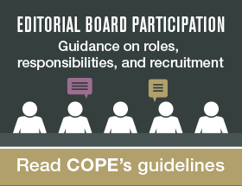
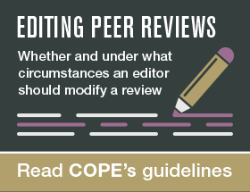
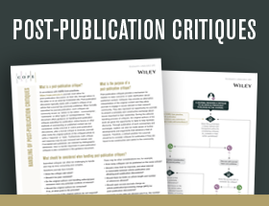
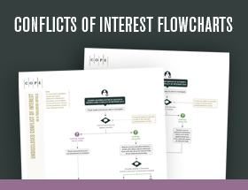
UPDATE OF COPE ACTIVITIES
New guidelines and discussion documents
Flowcharts new and updated
Notes:
The latest C0PE Digest includes a case discussion on gift authorship using an existing case with further analysis and guidance. A summary of our last Forum discussion on ethical considerations around book publishing. Plus the latest publication ethics news and events
The new look COPE Flowcharts are now available on the website, with more engaging visual styling, to make it easier to follow the guidance.
A Facilitation & Integrity FAQ has been published on the COPE website. This consists of a series of questions that are commonly asked of the F&I process.
The inaugural Member Insight newsletter was published in April. This newsletter is for members only (Digest is distributed to both members and non-members) and will offer more in depth analysis on the issues that are relevant to members. This issue focused on F&I issues and led with an editorial on how the F&I subcommittee works, as well as details on the F&I workshop held on 21 April.
The “Guidelines on Cooperation & Liaison between Universities & journal Editors on research integrity cases (CLUE)” have now been published. Former COPE co-Chair Chris Graf was involved in this group on behalf of COPE. COPE provided support, both in participating (Chris), and financially contributing to the workshop meetings.
The AHSS subcommittee have been considering our existing resources and have agreed to review some for the more pertinent guidance for AHSS communities to see if they are relevant for those working in those fields. A review of the Authorship discussion document is underway, looking at it from that AHSS perspective. We are also reviewing the data fabrication flowcharts from the same viewpoint.
Airtable – COPE’s new membership application processing database – has been launched. The new system will not only provide much more efficiency in tracking and processing applications, it will also enable us to have much more insight into who is applying to COPE, allowing us to tailor some of our guidance and support more appropriately.

Slide 6
UPDATE OF COPE ACTIVITIES
COPE virtual seminar
We had an amazing response to our online seminar: 255 individuals attending one or more sessions (84%). While the majority of attendees were from the UK and USA (67%), we also saw members from Australia, Brazil, Canada, Cayman Islands, China, Finland, France, Germany, Greece, Hong Kong, India, Iran, Israel, Italy, Japan, Republic of Korea, Malaysia, Mexico, Netherlands, Norway, Pakistan, Philippines, Spain, Sweden, Switzerland, Uganda, and Ukraine.
25 years of COPE
COPE will be celebrating its 25th anniversary in 2022. Watch this space as we finalise arrangements for celebrating this milestone during 2022.
Notes:
The latest C0PE Digest includes a case discussion on gift authorship using an existing case with further analysis and guidance. A summary of our last Forum discussion on ethical considerations around book publishing. Plus the latest publication ethics news and events
The new look COPE Flowcharts are now available on the website, with more engaging visual styling, to make it easier to follow the guidance.
A Facilitation & Integrity FAQ has been published on the COPE website. This consists of a series of questions that are commonly asked of the F&I process.
The inaugural Member Insight newsletter was published in April. This newsletter is for members only (Digest is distributed to both members and non-members) and will offer more in depth analysis on the issues that are relevant to members. This issue focused on F&I issues and led with an editorial on how the F&I subcommittee works, as well as details on the F&I workshop held on 21 April.
The “Guidelines on Cooperation & Liaison between Universities & journal Editors on research integrity cases (CLUE)” have now been published. Former COPE co-Chair Chris Graf was involved in this group on behalf of COPE. COPE provided support, both in participating (Chris), and financially contributing to the workshop meetings.
The AHSS subcommittee have been considering our existing resources and have agreed to review some for the more pertinent guidance for AHSS communities to see if they are relevant for those working in those fields. A review of the Authorship discussion document is underway, looking at it from that AHSS perspective. We are also reviewing the data fabrication flowcharts from the same viewpoint.
Airtable – COPE’s new membership application processing database – has been launched. The new system will not only provide much more efficiency in tracking and processing applications, it will also enable us to have much more insight into who is applying to COPE, allowing us to tailor some of our guidance and support more appropriately.

Slide 7
UPDATE OF COPE ACTIVITIES
COPE speaking events
Trevor Lane presented at the First J-STAGE Seminar 2021. Fundamental principles of peer review and peer review ethics, in July
Dan Kulp, COPE Chair, was invited to speak at the Fourth World STM Journal Forum, organised by the Chinese Association of Science and Technology, in July and also at the Chinese Academy of Sciences Seminar, in September, on the new trends and issues in international publication ethics and COPE’s recommendations
During peer review week in September, Dan also took part in the APS (American Physical Society) panel discussion on “The tension between transparency and confidentiality in peer review”
Kim Eggleton and Laura Wilson presented on diversity, equity and inclusion at the ISMTE Global Virtual Event this week
Notes:
COPE events
The COPE F&I workshop on 21 April was very well received with lots of interest and 46 members who attended on the day
The COPE webinar on diversity, equity and inclusion (28 May at 1.00pm BST) was also exceedingly well received by our membership. 207 delegates attended. Initial feedback is very positive.
The seminar will be conducted over the course of a week with an event being planned for each day. A virtual seminar, during the week of 27 September - 1 October 2021. While the programme is still in early stages of development it is expected these issues will be addressed: universities; gift authorship and citation manipulation; retractions and expressions of concern; book publishing workshop; and possibly an introduction to publication ethics webinar/workshop.
COPE speaking events
Rachel Safer: Author name changes, Association for Computing Machinery board meeting (March)
Dan Kulp: Name changes. CSE's annual conference (4 May)
Trevor Lane: Data sharing. CSE's annual conference (May)
Deborah Poff: Authorship, Ownership and Plagiarism. Duke University (25 March) and Retraction taxonomy, SSP (26 May)
Suzanne Farley: Session on how funders, journals, and publishers respond to new challenges for research integrity. WCRI virtual meeting (30 May - 2 June 2021).

Slide 8
Bias in peer review
Caroline Porter
COPE Trustee

Slide 9
Headlines
Survey 2021
Over ¾ of respondents somewhat agreed or strongly agreed that diversity and inclusion are important in peer review
Diversity and inclusion apply to:
Editors/Editorial boards of publications (90%)
Peer reviewers for publications (86%)
Peer review panels for job applications/promotions/tenure (82%)
Peer review panels for funding/awards (81%)
Kinds of things that have changed with respect to DEI in the organisation or editorial policies and practices in the last 3 years?
Nothing
Geographical diversity
More diverse reviewers
Attempts to increase diversity of ethnicities and cultural backgrounds
Greater diversity on editorial board/reviewer panel
Unconscious bias training

Slide 10
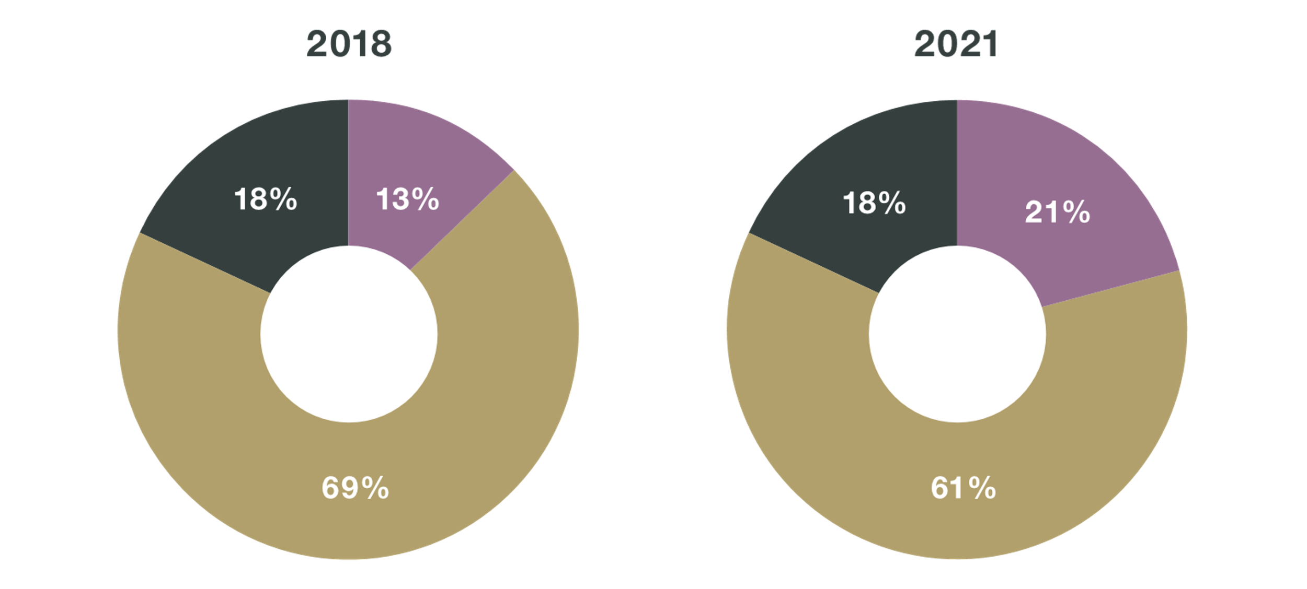
DIVERSITY SURVEY
Comparisons
My employer/publication provides in-house training to promote diversity and inclusion in peer review.
Key
Yes
No
Don't know

Slide 11
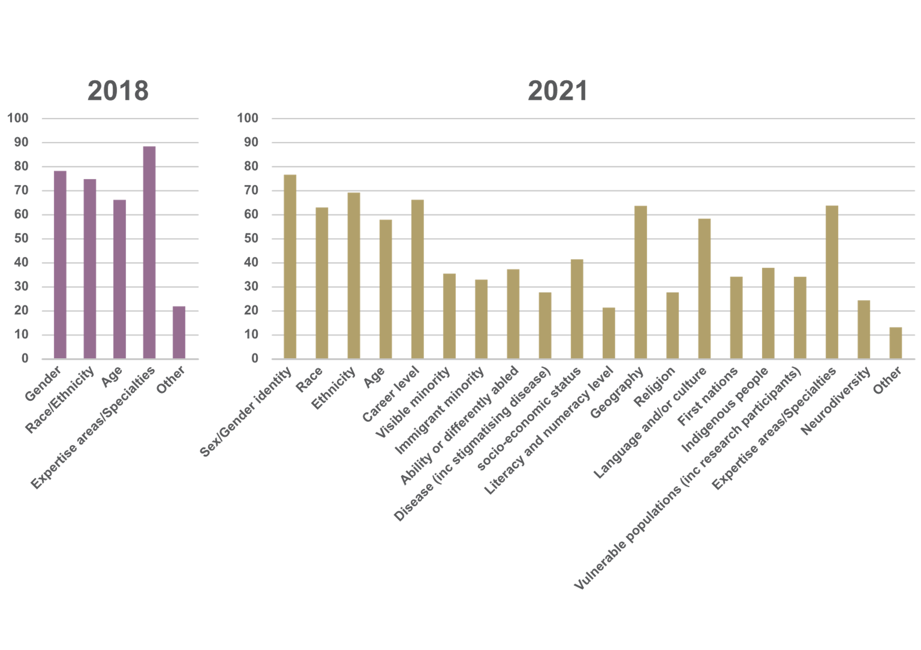
DIVERSITY SURVEY
Comparisons
What kinds of diversity are important in peer review
Key
2018
2021

Slide 12
Attitudes/policies
Survey 2021
My employer/publication (N=266)…
… values diverse involvement and opinions in its peer review process (69%)
… is actively working towards increasing the diversity in its peer reviewer pool (69%) NEW
… has policies to respond appropriately to alleged cases of discrimination in its peer review process (42%)
… has achieved an ideal level of diversity in its peer reviewer pool (30%)
… has diversity policies for selecting peer reviewers when evaluating individual manuscripts/applications (27%)
… has diversity policies for nominating/selecting members for its peer reviewer pool (26%)
… provides in-house training to promote diversity and inclusion in peer review (22%)
Notes:
… values diverse involvement and opinions in its peer review process, such as when evaluating individual manuscripts/applications (69%)

Slide 13
Free text comments
Survey 2021
“Diversity must be promoted and achieved without compromising the integrity of the process.”
“Diversity and inclusion in the process is essential in a global and diverse world.”
“We may never have a fully representative review panel but at least we can understand their biases.”
“Career stage and domain of expertise are more important in peer review.”
“Only knowledge and qualifications matter”
“The key issue in peer review is fair objective evaluation of submitted work.”

Slide 14
THANK YOU

Slide 15
facebook.com/publicationethics
Registered charity No 1123023
Registered in England and Wales, Company No 6389120
Registered office: COPE New Kings Court, Tollgate, Chandler's Ford, Eastleigh, Hampshire, SO53 3LG, United Kingdom
©2021 Committee on Publication Ethics (CC BY-NC-ND 4.0)
@C0PE
LinkedIn

